Slide 1
Object Oriented Software Engineering (OOSE)
22CS017
Software Quality Management

Slide 2
Index
Software Quality
Factor’s of Software Quality
Overview Quality Management
Software Quality Management
Quality Management for Projects or Programs
Practice Questions

Slide 3
Software Quality
Software Quality shows how good and reliable a product is. To convey an associate degree example, think about functionally correct software. It performs all functions as laid out in the SRS document. But, it has an associate degree virtually unusable program. even though it should be functionally correct, we tend not to think about it to be a high-quality product.
Another example is also that of a product that will have everything that the users need but has an associate degree virtually incomprehensible and not maintainable code. Therefore, the normal construct of quality as “fitness of purpose” for code merchandise isn’t satisfactory.

Slide 4
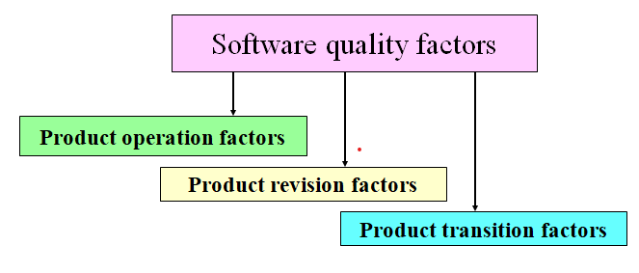
Factors of Software Quality

Slide 5
Product operation factors
•Correctness: extent to which a program fulfills its specification.
•Reliability: ability not to fail.
•Efficiency: use of resources execution and storage.
•Integrity: protection of the program from unauthorized access.
•Usability: ease of use of the software.

Slide 6
Product revision factors
•Maintainability: effort required to locate and fix a fault in a program.
•Flexibility: ease of making changes required by changes in operating environment.
•Testability: ease of testing the program to ensure that it is error-free and meets its specification.

Slide 7
Product transition factors
•Portability: Effort required to transfer a program from one environment to another system.
•Reusability: ease of re-using software in a different context.
•Interoperability: effort required to couple a system to another system.

Slide 8
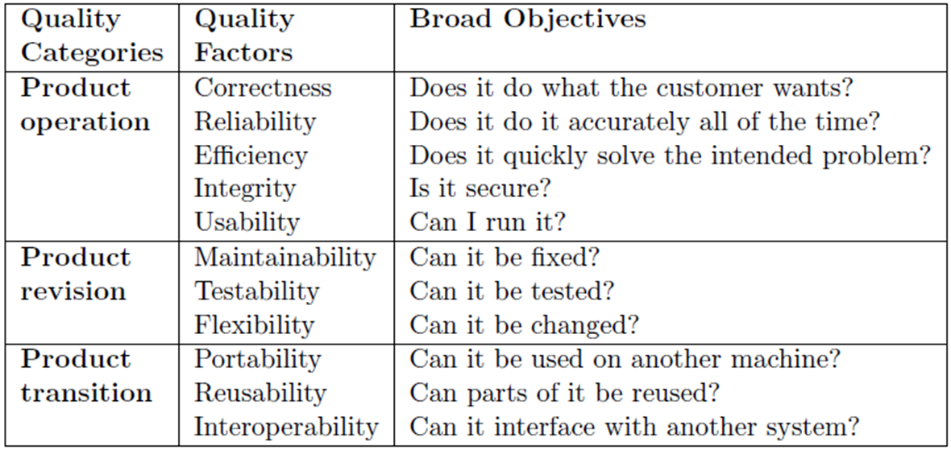
Software quality factors
Quality Control (QC): Techniques used to assure that a product or service meets requirements or goals.
Quality Assurance (QA): Actions at a management level that directly improve the chances that QC actions will be successful. Includes verification that QC was performed as planned.
Quality Management System (QMS): “A formalized system that documents the structure, responsibilities and procedures required to achieve effective quality management.”
Quality Plan (QMP): Primary document of a QMS that typically includes the Quality Policy, objectives, and written procedures.
Quality Policy: “The overall quality intentions and direction of an organization with regard to quality, determined by top management.”

Slide 9
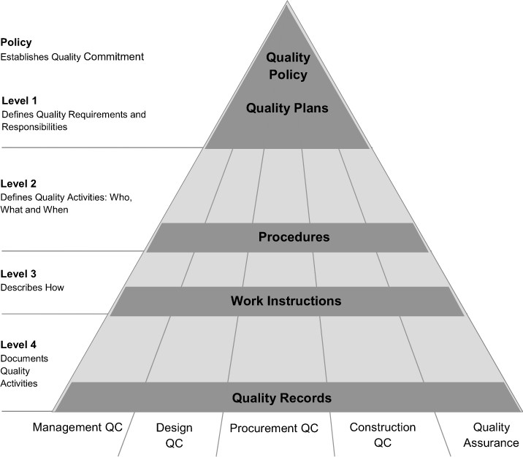
Overview Quality Management
Figure 1: Quality Management

Slide 10
Software Quality Management
Software quality management (SQM) is a management process that aims to develop and manage the quality of software in such a way so as the best ensure the product meets the quality standards expected by the customer while also meeting any necessary regulatory and developer requirements.
Software quality management activities are generally split up into three core components: quality assurance, quality planning, and quality control.
As quality control is often viewed as more a manufacturing term than a software development term), rather, linking its associated concepts with the concept of quality assurance

Slide 11
Software quality management
1. Quality assurance:-
This stage can include:
encouraging documentation process standards, such as the creation of well-defined engineering documents using standard templates
mentoring how to conduct standard processes, such as quality reviews
performing in-process test data recording procedures
identifying standards, if any, that should be used in software development processes

Slide 12
Software quality management
2. Quality planning:
Quality planning works at a more granular, project-based level, defining the quality attributes to be associated with the output of the project and how those attributes should be assessed.
Additionally, any existing organizational standards may also be assigned to the project at this phase.
Attributes such as "robustness," "accessibility," and "modularity" may be assigned to the software development project.

Slide 13
Software quality management
3. Quality control:
Activities include:
release testing of software, including proper documentation of the testing process
examination of software and associated documentation for non-conformance with standards
follow-up review of software to ensure any required changes detailed in previous testing are addressed
application of software measurement and metrics for assessment

Slide 14
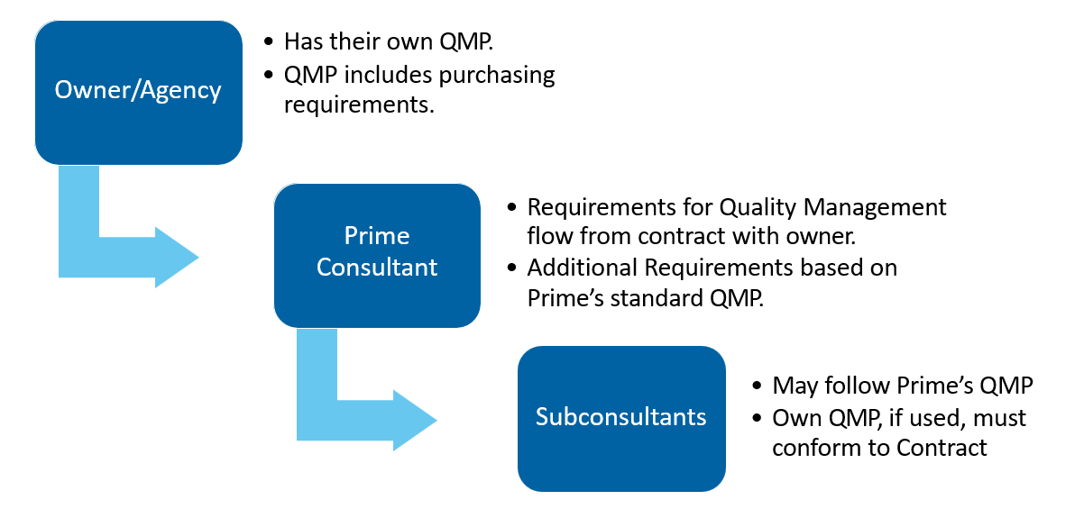
Quality Management for Projects or Programs
Figure 2: Quality Management

Slide 15
Practice Questions
Q1- Which requirements are the foundation from which quality is measured?
Hardware
Software
Programmers
None of the mentioned
Q2-Which of the following is not a SQA plan for a project?
a) evaluations to be performed
b) amount of technical work
c) audits and reviews to be performed
d) documents to be produced by the SQA group
Q3- Which of the following is not an appraisal cost in SQA?
a) inter-process inspection
b) maintenance
c) quality planning
d) testing
Q4- The primary objective of formal technical reviews is to find _________ during the process so that they do not become defects after release of the software.
errors
equivalent faults
failure cause
none of the mentioned

